Slide 1

ML 101 Course
Arush Garg
AI and Machine Learning Club
Overseas Family School

Slide 2
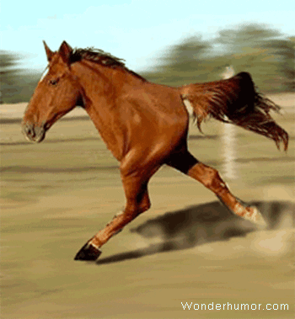

Course (bit.ly/ML_101)
Introduction to Machine Learning (ML)
Regression
Core ML Concepts
Classification
Decision Trees
Model selection and tuning
Unstructured data: Text
Neural Networks
Unstructured data: Images
Introduction to Deep Learning
Beyond Regression & Classification
Notes:
Welcome back to the Machine Learning 101 course. So far we have trained multiple ML models using structured data. Today we will learn how to train a model using “text” data.

Slide 3
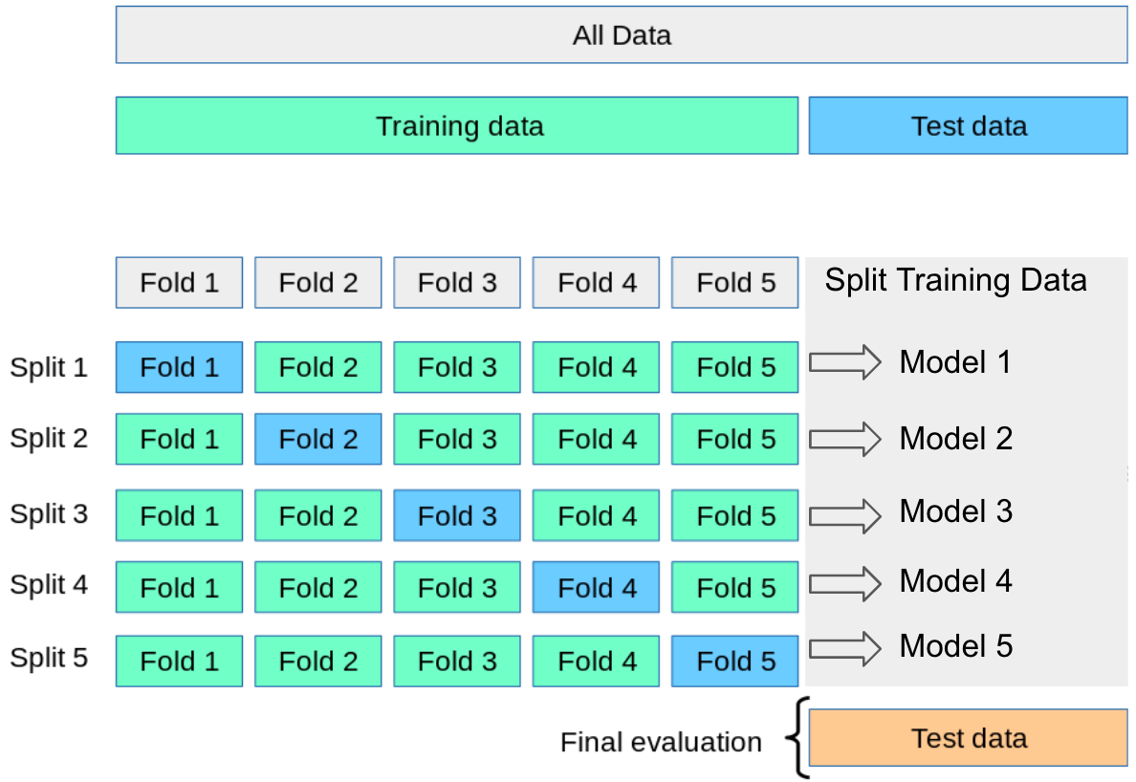
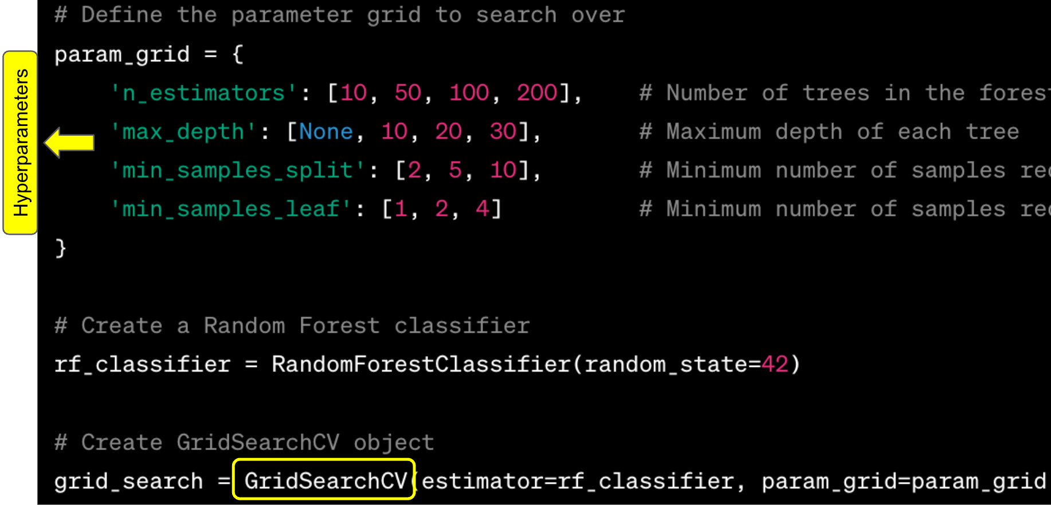
Recap
Supervised Learning
Linear Regression: Regression
Logistic Regression: Classification
Decision Trees & Random Forest : Regression & Classification
KNN: Regression & Classification
k-fold Cross Validation
Split training data into k parts. Use “1” part as validation set and “k-1” parts as training set. Train “k” models. Update model and repeat.
Helps with model tuning while avoiding “overfitting the test data” and “sacrificing valuable training-data as a dedicated validation set”.
Hyperparameter tuning
Difference between model “parameters” & “hyperparameters”
GridSearchCV: Specify various hyperparameter options that you want to explore. It trains a model for each hyperparameter combination and evaluates it using CrossValidation.
5 Fold Cross Validation
Hyperparameter tuning using GridSearchCV
Notes:
Till now, we have covered many different supervised learning models, from Linear Regression to Decision Trees.
In last lesson we talked about the problem of overfitting the test set and how k-fold Cross Validation can be used to avoid that.
We also discussed the difference between model parameters and hyperparameters and understood how GridSearchCV can be used for Hyperparameter tuning

Slide 4
Structured Data vs Unstructured Data
Structured Data = Tabular Data
This is the kind of data we have dealt with so far
Columns / Features are either numerical or categorical
One-hot encoding can be used to convert categorical features to numbers
Unstructured Data = Non-tabular Data
Text: e.g. predict the sentiment (+ve or -ve) from a movie review
Images: e.g. face recognition
Audio / Video: e.g. speech recognition / closed captioning
Notes:
So far, we have dealt with structured data, which is tabular. The features are either numerical or categorical, in which case they are one-hot encoded.
But many ML applications require the use of unstructured input data like “text”, “images” or “videos”. Such data requires some special handling before it can used for ML model training.

Slide 5

Sentiment Analysis: Text Classification problem
Intuition: The presence of terms / phrases like “wonderful”, “awful”, “happy”, “worth watching” can provide valuable information to a model in order to predict the review sentiment.
Notes:
Let’s say you are given a “movie review” and are asked to predict the “rating” or “sentiment” based on the review text. How will you go about coding such an Algorithm?
Your code will most probably look for terms or phrases like “wonderful”, “awful”, “worth watching” etc. to make the prediction, right?
We will use the same intuition when preparing the data for ML model training.

Slide 6
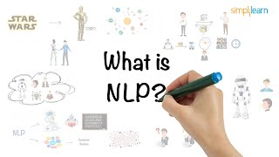
Feature Engineering for Natural Language Processing problems
Segmentation
Tokenization
Stemming
Lemmatization
Parts of Speech (PoS) Tagging
Named Entity Tagging
Simplilearn
Notes:
Let’s look at some of the most common techniques used to prepare text data for model training
(click)

Slide 7
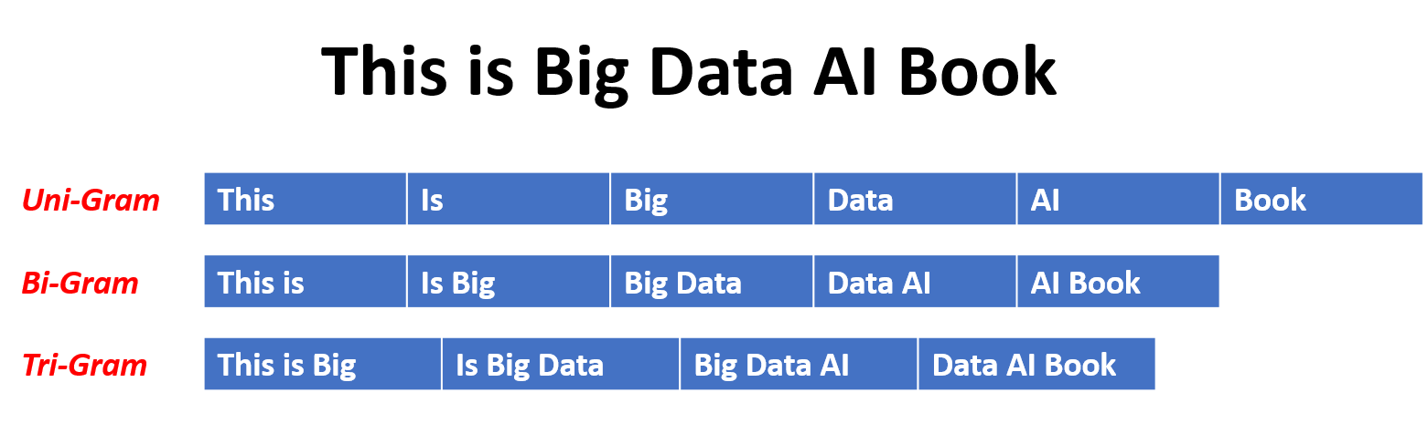
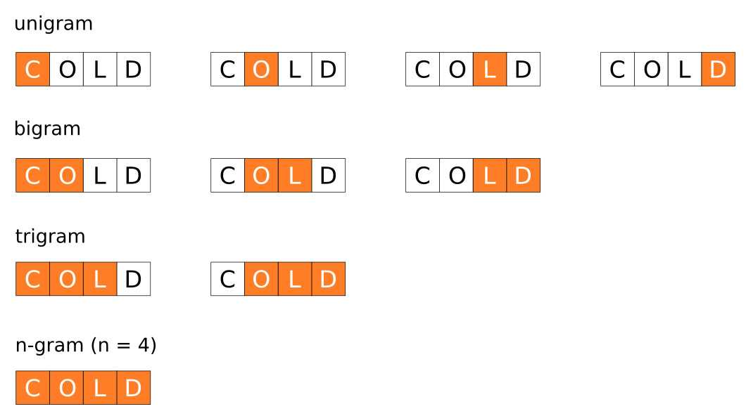
Data preparation for Text Classification
Data Cleaning
Lowercasing, Spell correction
Removing punctuation, special characters or symbols, html tags (often using “regular expressions”)
Tokenization
Convert a “blob of text” to a “list of tokens”. These tokens serve as a base for feature engineering
Ngrams: In addition to “words”, you can also add “phrases” as part of your token set
Bigrams & Trigrams capture more context than unigrams & often help improve model performance
Even “character ngrams” are very popular nowadays
Devopedia
Character ngrams
Notes:
Once we have cleaned the data by removing punctuations, stemming words, removed special characters and more, we can convert it into tokens.
By default every “word” in the text is considered one “token”. These are called unigrams. As unigrams lack surrounding context, we often also add bigram and trigram tokens to our feature dictionary.

Slide 8
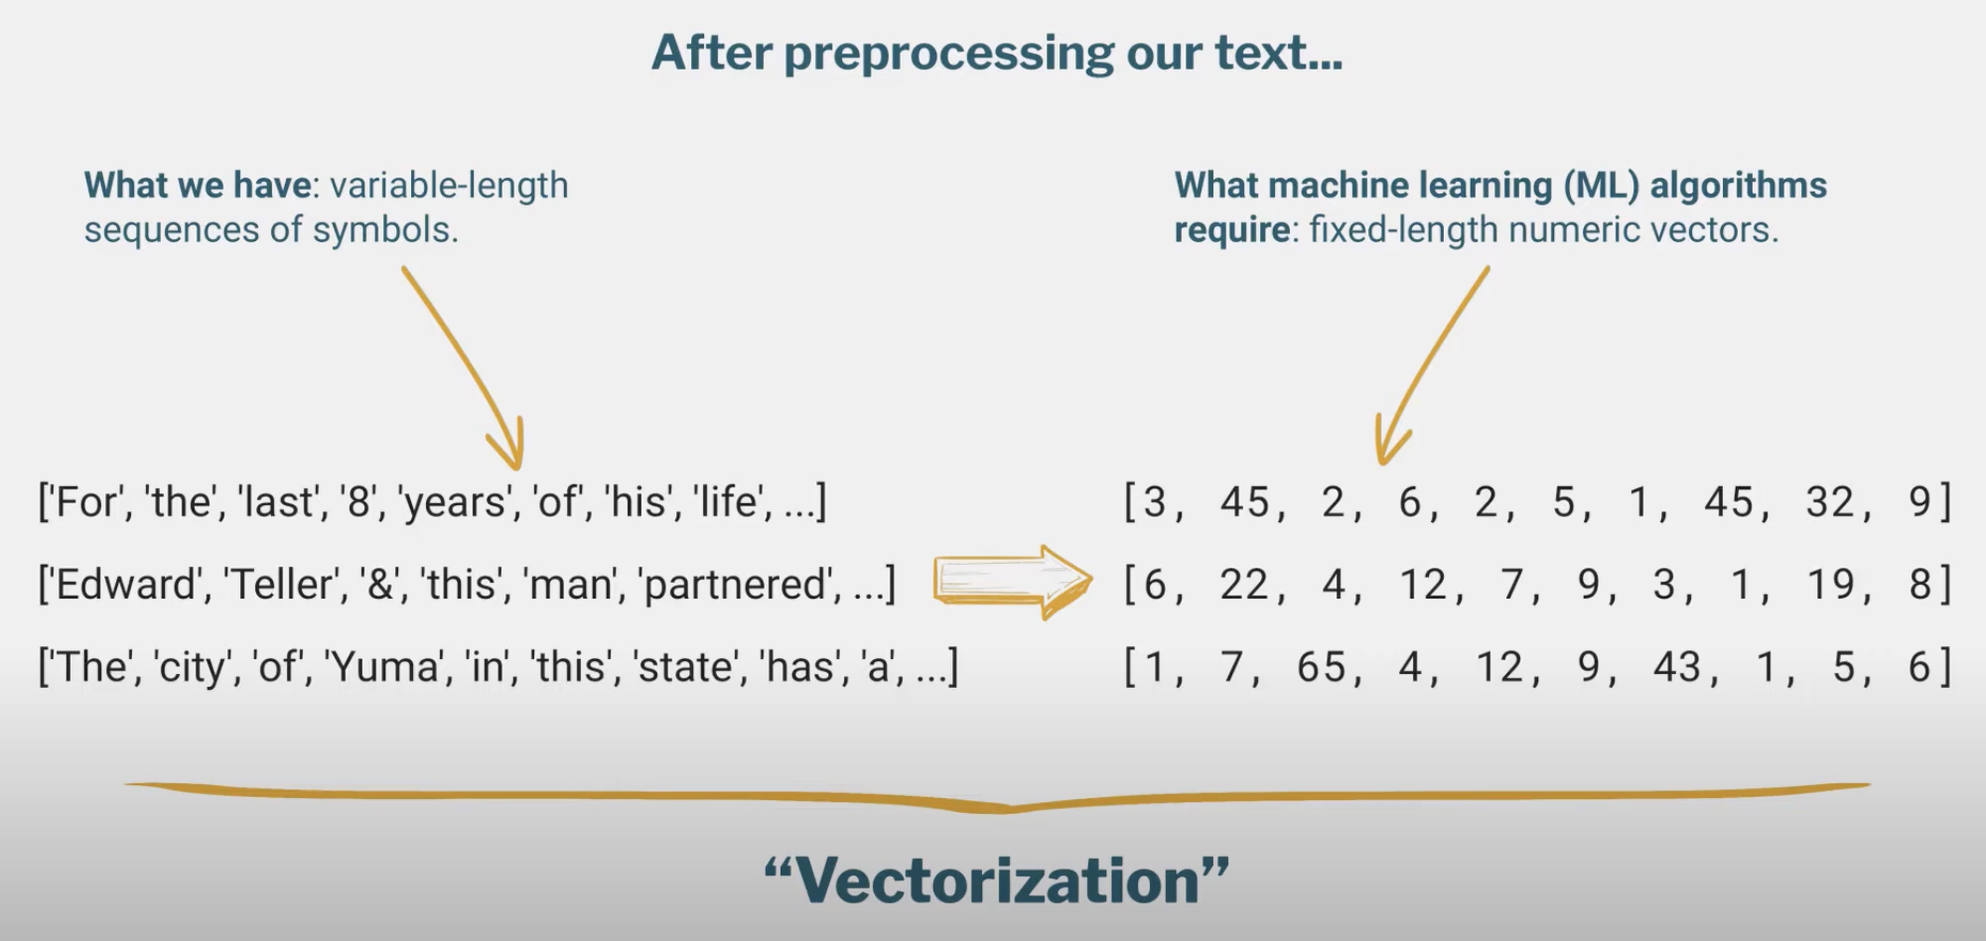
What we want to achieve?
Future Mojo
Notes:
Once we perform the data cleaning and tokenization steps, each movie review is now transformed to a “sequence of tokens”.
But this is still not an acceptable input for ML model for two important reasons. One, ML model expects numbers as input and two, ML model expects the “number of inputs, i.e. features” to be same for every input.
The process of transforming variable-length sequence of tokens to a fixed-length numeric feature vectors is called Vectorization. We will learn more about this in the next video.

Slide 9
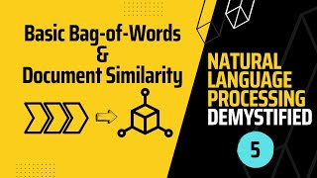
Vectorization: Bag of Words (CountVectorizer)
Future Mojo
Notes:
There are many approaches to Vectorizing. One of the simplest ones is a CountVectorizer.
(click)

Slide 10
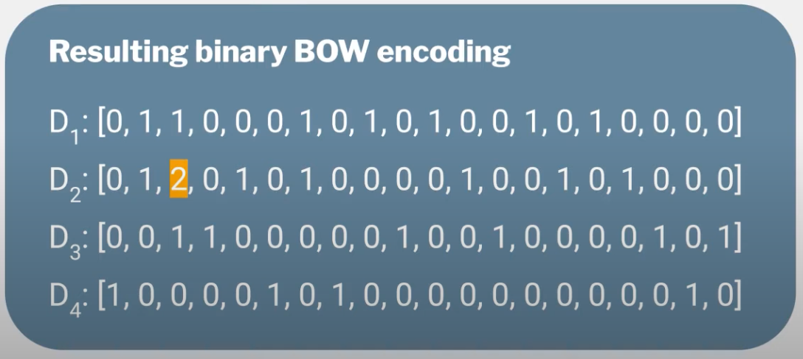
Model Training
ML Algorithm
Text Classifier
Naive Bayes
SVM
RandomForest
Neural Networks
Metrics: Precision, Recall, Accuracy
[Training Dataset] + [Sentiment Labels]
Same “pre-processing & feature engineering” steps need to be performed for any data we want to classify using this “text classification model”
Notes:
Now that we have transformed our “sequence of token” to “fix-length numeric feature vectors” we can feed this data as input to an ML algorithm and train a text classifier. This process is same as what we have followed in the past for structured data.
The number of features here is same as the length of our token vocabulary which can easily run into tens of thousands.
There are some models that are better suited to handle such large feature set, like Naive Bayes, SVM, RandomForest and NeuralNetworks. We have already covered RandomForest and will cover NeuralNetworks in the next lesson. We will briefly cover Naive Bayes and SVM in this lesson.

Slide 11
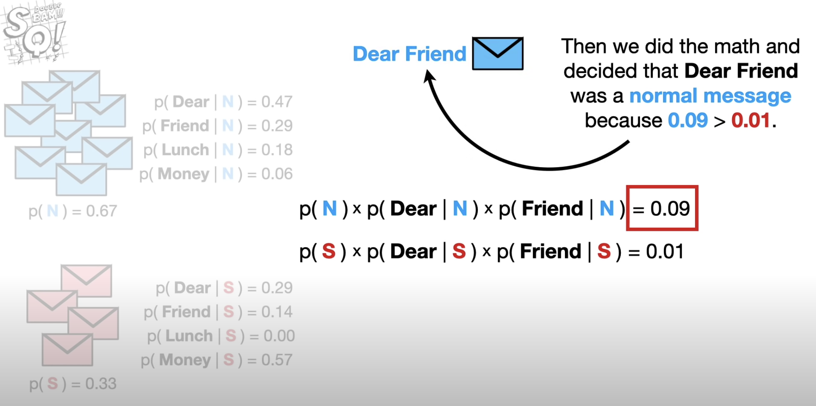
Intro to “Naive Bayes” Classifier: Probability based
Normal Messages
Prob of a msg being Normal
Spam Messages
For a given text (“Dear Friend”), calculate the class probability based on probabilities computed from the training data.
Probabilities of each word for “Normal messages” and “Spam messages”.
Prob of a msg being Spam
Future Mojo
Notes:
Idea behind Naive Bayes is to compute the probability of a feature given a class from the training data. And then use this probability information to compute the probability of a new input belonging to each class. Just like KNN, there is no parameter learning involved here. We just compute the probabilities from training data and remember those for making future predictions.
As we noticed earlier, a token’s presence or absence is a good indicator for detecting sentiment in the text. Hence Naive Bayes often performs well for text classification tasks.

Slide 12
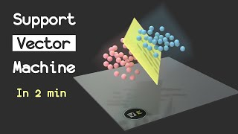
Intro to “SVM”
Visually Explained
Notes:
Another important model for Text Classification is Support Vector Machine, SVM for short. They are extremely powerful for this problem because of the large feature space they can handle.
(click)

Slide 13

Hands-on Exercises
Lesson 7 / TextClassification.ipynb
https://bit.ly/ML_101
Notes:
In today’s exercise, we will look at IMDB movie reviews and judge their sentiment as positive or negative.

Slide 14
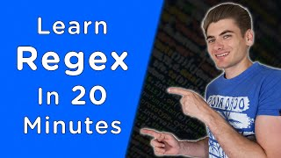

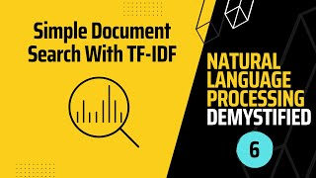
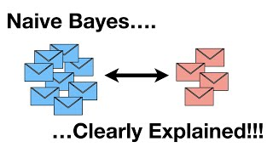
Further Reading / Watching / Doing
SpamFilter.ipynb
https://bit.ly/ML_101
Web Dev Simplified
Future Mojo - TFIDF is better than CountVectorizer
This channel has a playlist for NLP
StatQuest with Hosh Starmer
Notes:
To practise more with handling text, check out the problem in the problem.md file. This problem is a very common one; spam detection. For my approach, look at SpamFilter.ipynb, the repo has been linked in the description.
You can also watch these videos to learn more about Regular Expressions (also known as Regex), TFIDF vectorizer, which I have used in the Spam detection problem and naive bayes models.

Slide 15

Agenda for next class
Neural Networks
Introduction to Neural Networks
Hidden Layers, Back-propagation
What are Deep Neural Networks?
Activation functions, Softmax
Notes:
In the next class we will learn about Neural Networks. Neural Networks are the most powerful ML algorithms today and the base for all Deep Learning and Generative AI work

